Slide 1


Markov-state modeling of biomolecular systems
Toni Giorgino National Research Council of Italy toni.giorgino@cnr.it
www.giorginolab.it
@giorginolab
Thesis projects available
github.com/giorginolab/ Markov-Tutorial-BCN-2022
Master in Bioinformatics for Health Sciences
UPF Barcelona, 3 May 2022
Notes:
1
Good morning to everyone. My name is Toni Giorgino, and it is my pleasure to be a guest in your course.
Today I’d like to give you an overview of the use of Markov-state based methods in biomolecular simulations.

Slide 2
Introduction
The aim of this class is to provide a practical overview of Markov state models in computational structural biology
MSM emerging because:
reconstruct kinetic information*, including state transition networks, from simulated trajectories
start from unbiased simulations (no a priori reaction coordinate hypothesis necessary)
microsecond-scale (high-throughput) trajectory data are becoming accessible (e.g., with GPUs)
Success cases: ab initio folding, drug binding, peptide binding, …
* as well as the corresponding structures
Notes:
Markov-state modelling techniques, MSM for short, are a relatively new methods to analyze large sets of trajectories.
They have been first published around 2009. The idea behind MSM is that they enable the reconstruction of structural, thermodynamic and kinetic information from simulated trajectories. Importantly, they can be constructed on the basis of unbiased simulations, which means that one does not need to set a reaction coordinate a priori.
On the other hand, they require large-scale data, generally beyond microseconds, but this is becoming more and more accessible.
There are several success cases in the literature, as we will see in the last slides and in the references that I will provide you: reconstruction of folding pathways of peptides ab initio, drug binding, modulation of disordered ensembles, and so on.

Slide 3
Motivation
Can we use an ensemble of simulations to estimate dynamic behaviours which happen on timescales longer than each of the observed trajectories?
In other words, can we leverage several “short-sighted” (non-equilibrium) observations to extrapolate long-time behaviour?
Notes:
One important point, the take-home message if you want, is that the motivation for MSM is to use multiple simulations, call them ensembles, to estimate molecular behavious that happen at timescales longer than the individual trajectories that we can simulate.
In other words, we can leverage several parallel “short sighted” observations to extrapolate long-time behaviour.

Slide 4
The general idea
Notes:
Let me try to convey you the general idea of how MSM stands with respect to other methods.

Slide 5
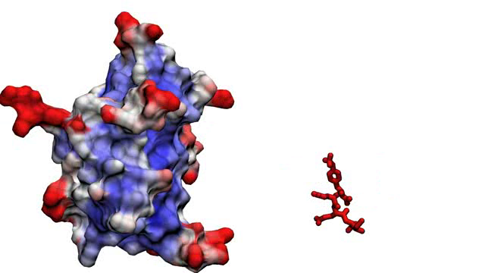



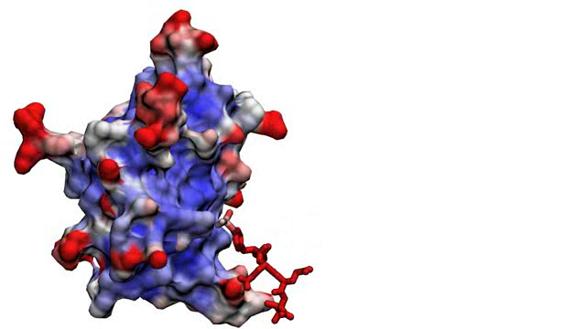
Unbiased sampling
Biased sampling
Markov-state modeling
A
A
A
B
B
B

Slide 6
Unbiased sampling
System evolves in time*.
We do not “guide” the system with biases in any particular direction.
Pro: Kinetics are “true”
Con: Slow. Observations (=sufficient sampling) may well be unfeasible.
A
B
* Under the influence of internal end external forces designed to approximate “real” ones.
Notes:
I think we are all familiar with unbiased sampling, which is when we simply leave the system to evolve under the influence of internal forces designed to represent realistically those of the physical system. They are collectively called the forcefield. You turn on the integrator, and observe the system diffusing freely.
Say that state A is the reactants, and state B the product, of any reaction of your choice (in this case a peptide bidning, but could be anything like folding, unbinding, and so on).
Since the forces are “natural”, the time for the system to move from A to B is, in principle, the “on” kinetics. This is nice, because it means that our dynamics is in a sense “real”, but this time-scales may well be very long, and require much longer than the amount of computer resources that we have at our disposal.
In practice, many interesting biomolecular are not addressable by unbiased sampling.

Slide 7
Biased sampling
Various strategies* exist to “push” the system towards desired states
Pros: Sampling is accelerated..
Can recover ΔG.
Cons: Biasing “direction” must be set, often not trivial. Kinetics (in general) are altered.
A
B
* Examples: metadynamics, steered MD, …
Notes:
For this reason, biased sampling methods have been developed. There are many of them, and you are probably familiar with metadynamics.
The point of all is to add external forces, or biases, that drive the system in certain ways. For metadynamics, for example, you add gaussian potentials
to move the system’s projection on a reaction coordinate out of free energy minima.
Biased sampling methods have the disadvantage that finding this reaction coordinate may not be trivial. Also, in general you won’t have an indication
of the kinetics, because of the forces you are adding to the system.

Slide 8

Markov-state modeling
Decompose a system in multiple states. Use shorter trajectories to compose a statistical* picture.
Pros: True kinetics.
No need to pre-set a reaction coordinate.
Cons: Non obvious (but software helps).
Sampling still needed for convergence.
A
B
* We’ll see Markov-based formalism, but others exist, such as milestoning
Notes:
Markov state models represent yet another approach. You decompose the set of possible states of the system into “microstates”. Then, you use short
trajectories to see how many times the system moves from one microstate to the other, essentially by counting. You do not add forces.
The advantage is that, without added forces, you do not need to set a reaction direction a priori. Also, you can recover the actual kinetics of the system.
On the other hand, of course, the methods is somewhat complicated. And it does not save you from the need to accumulate sufficient sampling. In
other words, all of the relevant microstates have to be visited several times.

Slide 9
Decomposing the state space
Notes:
The key is therefore decomposition of the state space.

Slide 10

1 2 3 4 5 …
Notes:
I’ll show this concept with one example. Here we have a protein domain (the SH2 domain) and a peptide, which incidentally is recognized with high specificity.
Assume, for a second, that the only structural parameter determining the progress of bidning is the position of the center of mass of the peptide.
Then, I can discretize, or partition the space around the protein in small subdomains. They may be cubic, or not, it does not matter. What matters
is that there is a finite number of them, and that I label all of them with a number.
At any given time, the center of mass of the peptide is in one cell, so I say that the system is in a given state, an integer.

Slide 11

Count the state transitions made within a time interval (τ)
T₅₆=1
1 2 3
4 5 6 7 8 9 …
T₅₂=2
T₅₈=1
T₅₅=1
Total: N₅=5
Notes:
Now comes the interesting part. I set a time interval of tau. I check how does the ligand move between time T, and T plus tau.
Suppose that, in the course of the trajectory, the peptide passed five times through state 5.
Consider each of them separately. One of those times, after tau picoseconds, the peptide ended up in state 6.
In two times I have seen it going to state 2.
Once I have seen it going to state 8. In one case, it did not leave the state 5.
I record all of those counts.

Slide 12

T₅₆=1
p₅₆ = 1/5 = 0.2
T₅₂=2
p₅₂ = 2/5 = 0.4
T₅₈=1
p₅₈ = 1/5 = 0.2
T₅₅=1
p₅₅ = 1/5 = 0.2
N₅=5
p_{5✵} = Σ_{i} p_{5i} = 1
1 2 3
4 5 6 7 8 9 …
 | 1 | 2 | … | 5 | 6 | 7 | 8 | …
5 |  | 0.4 |  | 0.2 | 0.2 |  | 0.2
Row 5 of the transition probability matrix P
Notes:
Now, more interesting than the counts, is the probabilities. What is the probability that, given that I am in state 5, I end up in 6, 2, 8 and so on?
Probabilities are just counts T normalized by N. Note that they sum to one, because each destination is mutually exclusive.
I record my observations in a row. This will become row 5 of the so called “transition probability matrix”, which is central to MSM.
Of course the trajectory will visit other states, not just 5. This means that in principle I can compute all rows of P. Again, sum of each row of matrix P is one.

Slide 13
Important
States are more general than a “location in space”.
For example, different conformations of the same structure may count as different states.
The partition (discretization) of the system’s configuration space in states is up to the user.
1,2 3,4 5,6 …
Notes:
Up to now I used spatial binning as an example. However, states may be more abstract. For example, imagine, as it is in reality, that the peptide orientation, or flexibility, play a role in binding. Then, we can decide that each spatial location corresponds to multiple states, one per orientation.
The logic of counting transitions would still hold, but our discretization of the possible configurations would be more fine.
Of course, the total number of states would grow. There is a limit to the number of states because then the matrix becomes too sparse, and many states would not be visited.

Slide 14
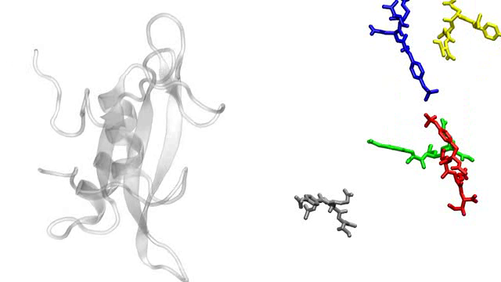
1 2 3 4 5 …
Notes:
Before we mentioned the fact that we can merge multiple trajectories. This is easy. Imagine that you simulated the same system several times, independently. Then, each replica of the ensemble would contribute its own transition counts.

Slide 15
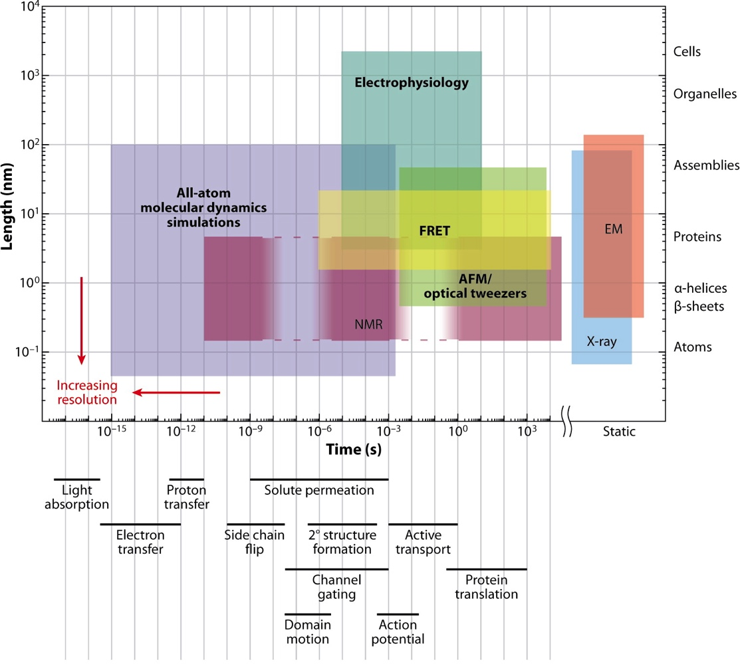
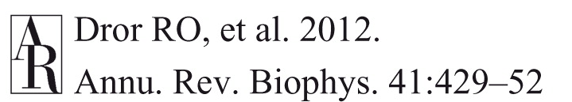
Notes:
This is a famous slide showing the spatial and temporal scales that can be achieved with various experimental techniques, and then with simulations.
Observing “slow” phenomena by simulation is prohibitive (thick line). Our Markov tradeoff, in principle, enables to use multiple short trajectories instead of one long one.

Slide 16
Learning transition matrices from trajectories

Slide 17
Markov models
Total sampled time (e.g. 100 μs)
Define the discrete state of the system in discrete time (e.g. via reaction coordinates)
. . .
Lag time τ (here: 4 time units)
Compute the transition probability matrix sliding a window of lag time τ
To
To
0 | 0 | 0
0 | 0 | 0
0 | 0 | 0
0 | 0 | 1
0 | 0 | 0
0 | 0 | 0
From
From

Slide 18
Markov models
Total sampled time (e.g. 100 μs)
Define the discrete state of the system in discrete time (e.g. via reaction coordinates)
. . .
Lag time τ (here: 4 time units)
Compute the transition probability matrix sliding a window of lag time τ
To
To
0 | 0 | 1
0 | 0 | 0
0 | 0 | 0
0 | 0 | 1
0 | 1 | 0
0 | 0 | 0
From
From

Slide 19
Markov models
Total sampled time (e.g. 100 μs)
Define the discrete state of the system in discrete time (e.g. via reaction coordinates)
. . .
Lag time τ (here: 4 time units)
Compute the transition probability matrix sliding a window of lag time τ
To
To
0 | 0 | 1
0 | 1 | 0
0 | 0 | 0
0 | 0 | 1
0 | 1 | 0
1 | 0 | 0
From
From

Slide 20
Markov models
Total sampled time (e.g. 100 μs)
Define the discrete state of the system in discrete time (e.g. via reaction coordinates)
. . .
Lag time τ (here: 4 time units)
Compute the transition probability matrix sliding a window of lag time τ
To
3 | 0 | 2
1 | 3 | 0
1 | 2 | 1
From

Slide 21
Markov models
Total sampled time (e.g. 100 μs)
Define the discrete state of the system in discrete time (e.g. via reaction coordinates)
. . .
Lag time τ (here: 4 time units)
Transition counts
Transition probabilities
To
To
Σ_{j}
3 | 0 | 2
1 | 3 | 0
1 | 2 | 1
3/5 | 0 | 2/5 | 1
¼ | ¾ | 0 | 1
¼ | 2/4 | ¼ | 1
From
From
Normalize by rows
P_{ij}

Slide 22
Repeat until the end of the trajectory.
Note the Markovian assumption: transition probabilities do not depend on history (neither, for us, on time).
(Note how “Early” and “late” events are squashed in the same matrix.)

Slide 23
Discrete-time Markov Chains
Notes:
Up to now I provided an overview to convince you of the centrality of discretization and counting. Now let’s see a little what can we do with this model.

Slide 24

Discrete Time Markov Chains
A random process.
The system’s state is a discrete variable.
It undergoes transitions between states at uniformly-spaced (discrete) time points.
Transition probabilities do not depend on the previous history of states (memorylessness).
Andrei Markov 1856-1922
B
A
Notes:
First of all, we are talking about discrete time markov chains. Read.

Slide 25
Transition probability matrix
0.3
B
P_{ij} = Probability to change state from i to j at each time point
0.7
0.4
A
j
 | A | B
A | 0.6 | 0.4
B | 0.7 | 0.3
0.6
i
Notes:
The central structure of a MC is the transition probability matrix. Suppose we have two states. A and E. For each we have a probability to stay (after the time interval tau) or to change. We collect these probabilities in a suitable matrix.

Slide 26
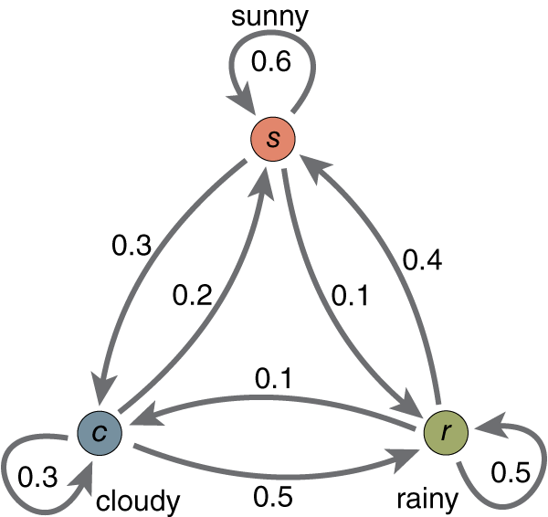
Let’s make one with 3 states…
[,1] [,2] [,3]
[1,] 0.6 0.3 0.1
[2,] 0.2 0.3 0.5
[3,] 0.4 0.1 0.5
1
Q: Can you match state names
with matrix
indices?
= p_{rs}
2
3
Notes:
Two states are not very interesting though. Let’s try with three. Let’s say that we model the weather. The weather of any given day may be ither sunny, cloudy or rainy.
The weather on any given day maybe either sunny cloudy or rainy. Here on the graph you can see the probability is to transition from one state to the other. For example suppose that today is rainy. What is the probability that tomorrow is sunny? It’s 0.4 recall this value P_rs.
On the top right I have prepared the transition probability matrix corresponding to the graph. Can you match the state numbers with the state names?

Slide 27
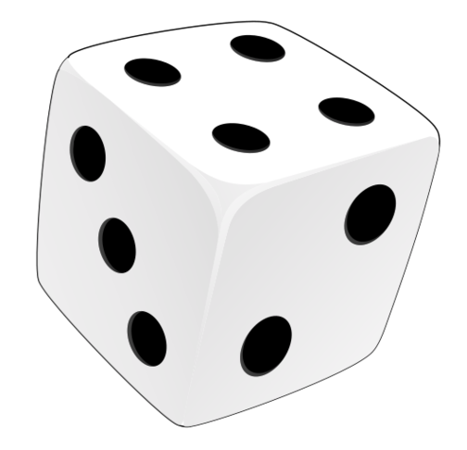
Let’s generate samples…
1
Start e.g. from state 1
(we’ll use numbers from now on).
Play the game and follow the Markov chain for many (discrete) time steps.
2
3
1
1
1
2
…
t = 0 t = 1 t = 2 t = 3 t_{i}
1 1 1 2 2 3 3 1 1 1 2 2 2 2 1 1 1 1 1 1 3 1 1 1 1 2 3 1 1 3…
https://github.com/giorginolab/Markov-Tutorial-UniPd-2022
Notes:
The first thing that we can do with this graph that is with its probability matrix is to generate samples from it.
Let’s start at times zero from state 1. We roll the dice and follow the probabilities of going from sunny to any other state. Turns out that the state for the next day, time = 1, is again state one.
This is not surprising because when you are in state one the the highest probability is to remain in itself.
Now we go to time two. Again we follow the probabilities, which are the same as before by constructions, and it turns out that we again remain in state one.
Then we go to time three. Again we roll the probabilities, but this time we got to state two.
You can continue this process indefinitely. I did extract 30 samples and this is the sequence of states that I got. If you want to produce this example you can go on this website where I have put all the code.

Slide 28

Equilibrium probabilities
1
Question: if we play the game a very long time, what fraction of time would we spend in each state?
That is the asymptotic (equilibrium) distribution.
I.e., the probability of finding the system in a given state.
2
3
1 1 1 2 2 3 3 1 1 1 2 2 2 2 1 1 1 1 1 1 3 1 1 1 1 2 3 1 1 3…
(1000 times)
1 2 3
431 220 349
p∞(1) = 0.431
p∞(2) = 0.220
p∞(3) = 0.349
Σ_{i} p∞(i) = 1
https://github.com/giorginolab/Markov-Tutorial-UniPd-2022
Notes:
Now let’s see the first question that we can ask on our model.
Suppose that Suppose that we play this game for a very long long time, for example that I extract 1000 samples. How many times would I be in state one, state two or state three?
I can simply do it by counting: I just tally how many times I see the states, then I divide by the number of samples that I’ve taken. The numbers that you see are the results.
It’s clear that state 1, in the long term, is the most probable. These are our so-called asymptotic, or equilibrium, probabilities.

Slide 29
Equilibrium probabilities
1
Question: if we play the game a very long time, how much time would we spend in each state?
That is the asymptotic (equilibrium) distribution.
I.e., the probability of finding the system in a given state.
I.e., the free energy (ΔG) of that state!
2
3
1 1 1 2 2 3 3 1 1 1 2 2 2 2 1 1 1 1 1 1 3 1 1 1 1 2 3 1 1 3…
(1000 times)
1 2 3
431 220 349
p∞(1) = 0.431
p∞(2) = 0.220
p∞(3) = 0.349
G₁ = -k_{B}T log(p₁) ≃ 0.50 kcal/mol
G₂ = -k_{B}T log(p₂) ≃ 0.91 kcal/mol
G₃ = -k_{B}T log(p₃) ≃ 0.63 kcal/mol
ΔG₁₁ ≐ 0 kcal/mol
ΔG₂₁ ≃ 0.37 kcal/mol
ΔG₃₁ ≃ 0.18 kcal/mol
Σ_{i} p∞(i) = 1
https://github.com/giorginolab/Markov-Tutorial-UniPd-2022
Notes:
One important features of equilibrium probabilities is that they represent nothing less than the free energy of the system.
To compute free energy is it’s enough to compute minus the Boltzman constant, times the temperature, times for the logarithm of the probability.
Since to be energies have an arbitrary zero it is convenient to assign to the most probable state the free energy of zero and to make sure the others in comparison, as I have done in the third column.

Slide 30

Equilibrium probabilities
1
Question: if we play the game a very long time, how much time would we spend in each state?
That is the asymptotic (equilibrium) distribution.
I.e., the probability of finding the system in a given state.
I.e., the free energy (ΔG) of that state!
2
3
1 1 1 2 2 3 3 1 1 1 2 2 2 2 1 1 1 1 1 1 3 1 1 1 1 2 3 1 1 3…
(1000 times)
Sample and count
[,1] [,2] [,3]
[1,] 0.6 0.3 0.1
[2,] 0.2 0.3 0.5
[3,] 0.4 0.1 0.5
Compute eigenvectors: same result in one shot
Compute eigenvectors
of matrix P
https://github.com/giorginolab/Markov-Tutorial-UniPd-2022
Notes:
Now this is nice however usually I don’t have the luxury of a very very long trajectory from which up to obtain the state accounts. Very important property of Markov processes is that I can obtain the equilibrium probabilities directly from the transition probability matrix.
This is done mathematically with the procedure which is called extracting the eigenvectors of matrix P. Again, if you are interested, the code in the website shows the details.

Slide 31
Intermezzo
Google’s PageRank

Slide 32
Kinetics
1
Question: if we start from 1, how many steps on average do I wait to reach 2?
This is the 1 → 2 mean first passage time
I.e., the (inverse) transition rate (1/k_{on}) between those states!
2
3
1 1 1 2 2 3 3 1 1 1 2 2 2 2 1 1 1 1 1 1 3 1 1 1 1 2 3 1 1 3…
3
3
11
2
2
1
1
And so on…
Answer: average all the numbers in red.
(Actually done mathematically on P_{ij})
Obviously one can ask the same question about any i → j
Remember that time is steps × τ
https://github.com/giorginolab/Markov-Tutorial-UniPd-2022

Slide 33
Committor
1
Question: if we start from 1, what is the probability to pass through 2 w.r.t. 3 first? (regardless of the path)
This is the 1 → {2,3} committor probability
States which are equally probable to fall back to the “reactants” or advance to “product” state form the transition state.
2
3
1 1 1 2 2 3 3 1 1 1 2 2 2 2 1 1 1 1 1 1 3 1 1 1 1 2 3 1 1 3…
2
2
3
2
2
3
And so on…
2
2
Answer: compute the fraction of end-in-2 vs end-in-3.
(Actually done mathematically on P_{ij})
https://github.com/giorginolab/Markov-Tutorial-UniPd-2022

Slide 34
Markovianity
The state transition probabilities only depend on the current state. Examples:
Today’s weather, not yesterday’s
Where the ligand is, not how did it got there
The property may be false at short timescales but true at longer ones: study varying τ
It does depend on the chosen states: study varying state discretization

Slide 35
Back to molecules:
>> 1 dimension
Notes:
Now let’s leave our idealized 3-states world and go back to more complicated systems.

Slide 36
Handling real trajectory data is far more complex
The system has continuous degrees of freedom (e.g. angles, positions)
There are many of them (thousands)
The number of discrete states we can handle it O(10,000) maximum
Too many states → they won’t be visited, insufficient counts
Notes:
As we know even the simplest molecule of biological interest would be quite more complex to model.

Slide 37
MSM-based analysis overview
Full system trajectory
Projection (metric)
Clustering (discretize states)
Markov state model
Dimensionality reduction (TICA, optional)
Equilibrium probabilities (ΔG) and kinetics
MSM proper – this is the part we have seen so far

Slide 38
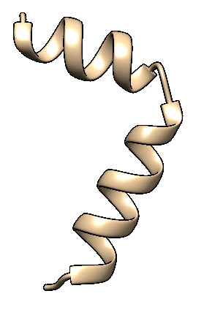
Metric projection
The first step is to project the system state in a lower-dimensional space (“metric”). Many choices are available, e.g.
Manually chosen distances
Atom coordinates
N phi/psi Ramachandran angles
Distance matrix
Contact matrix
…

Slide 39
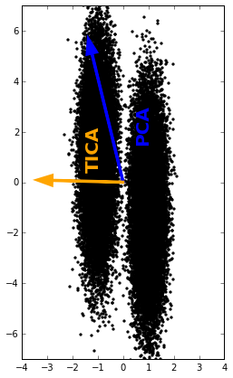
Time-lagged independent component analysis
The feature space dimensionality may still be too high
Do a further low-dimensional projection on the “slow” degrees of freedom: TICA
It is based on lagged autocorrelation
Contrast with PCA, which fits the “most elongated” ellipsoid, ignoring time
CV2
CV1
J. Chem. Phys. 139, 015102 (2013).
Notes:
In general, metric projections leave us in continuous spaces of high dimensionality. For example, a peptide of 20 aa has 40 Ramachandran angles, that is 40 dimensions.
This is too much to build a model. We therefore use a method called time-lagged component analysis to select just a few (generally 2 or 3) linear combinations of the
original features. The projection selects a linear combination of input degrees of freedom that decorrelate slowly.

Slide 40
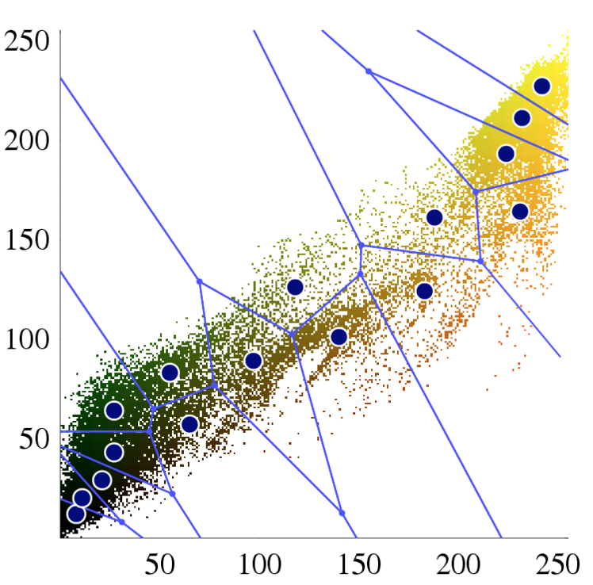
Clustering (1st level)
Now move to a discrete state space
Reduction from the low-dimensional space is done by clustering
Usually called “microstates”
Several algorithms are implemented in MSM packages (e.g. grid; k-means; etc. We won’t discuss them)
x₂ (E.g.: TICA axis 2)
x₁ (E.g.: TICA axis 1)
https://en.wikipedia.org/wiki/K-means_clustering

Slide 41
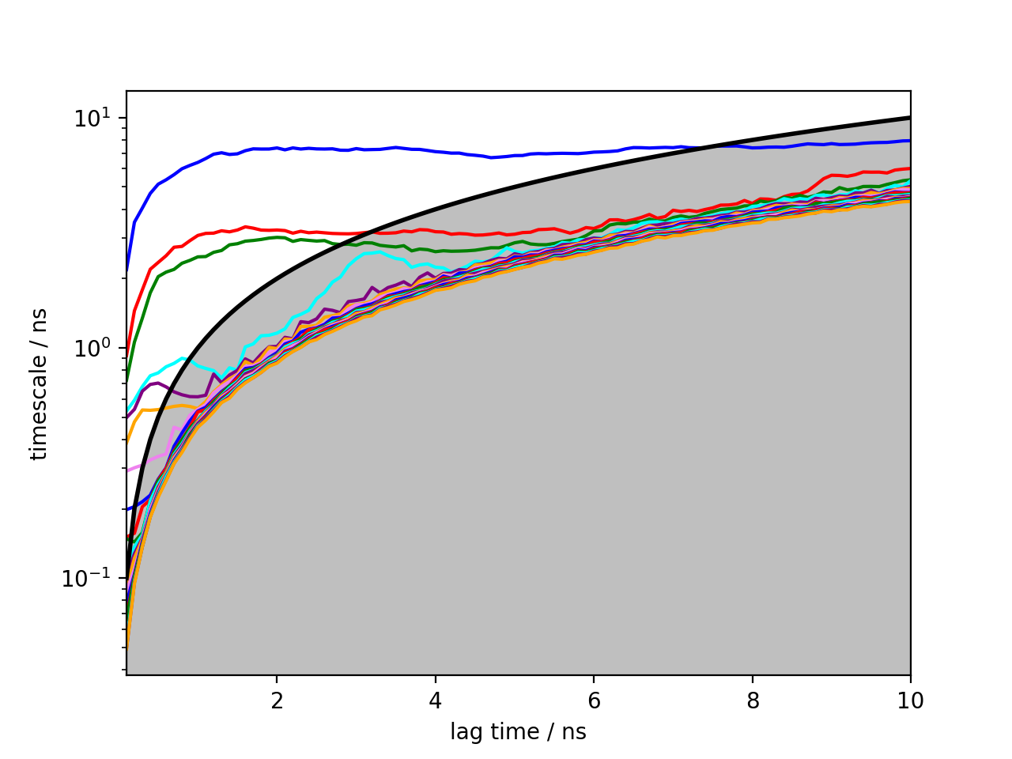
Even when merging multiple trajectories, making efficient use of sampling does not dispense us from sampling the phase space
Ace-Ala3-Nme
Part of examples at: github.com/tonigi/PLUMEDws2017
6 Ramachandran angles
The system is trapped
How to «shoot» trajectories:
«bathtub» not ok
«shower» maybe
adaptive spawning
or your favourite string-like method
not ok
possibly ok

Slide 42
Examples from the literature

Slide 43
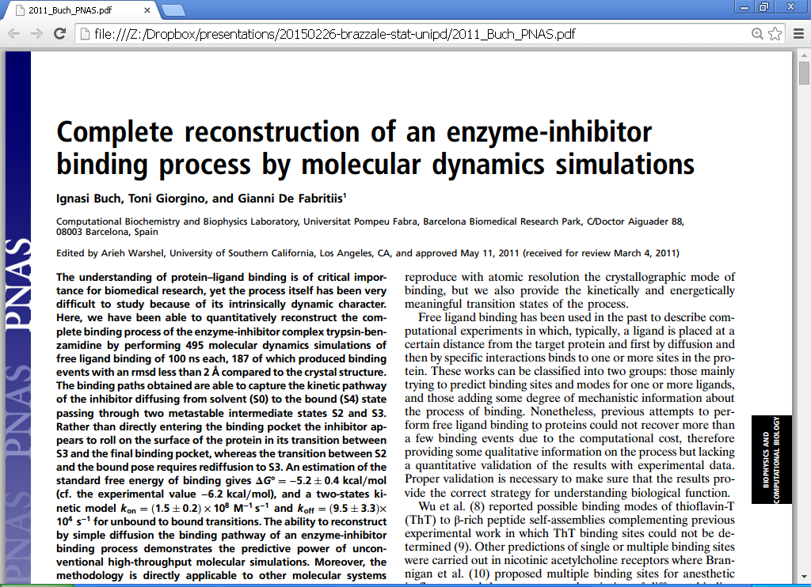
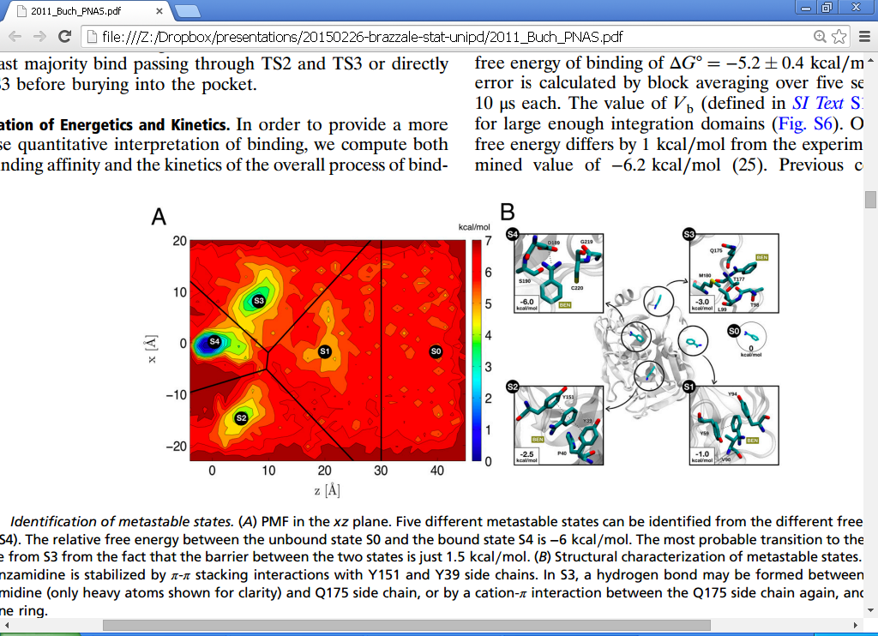

Slide 44
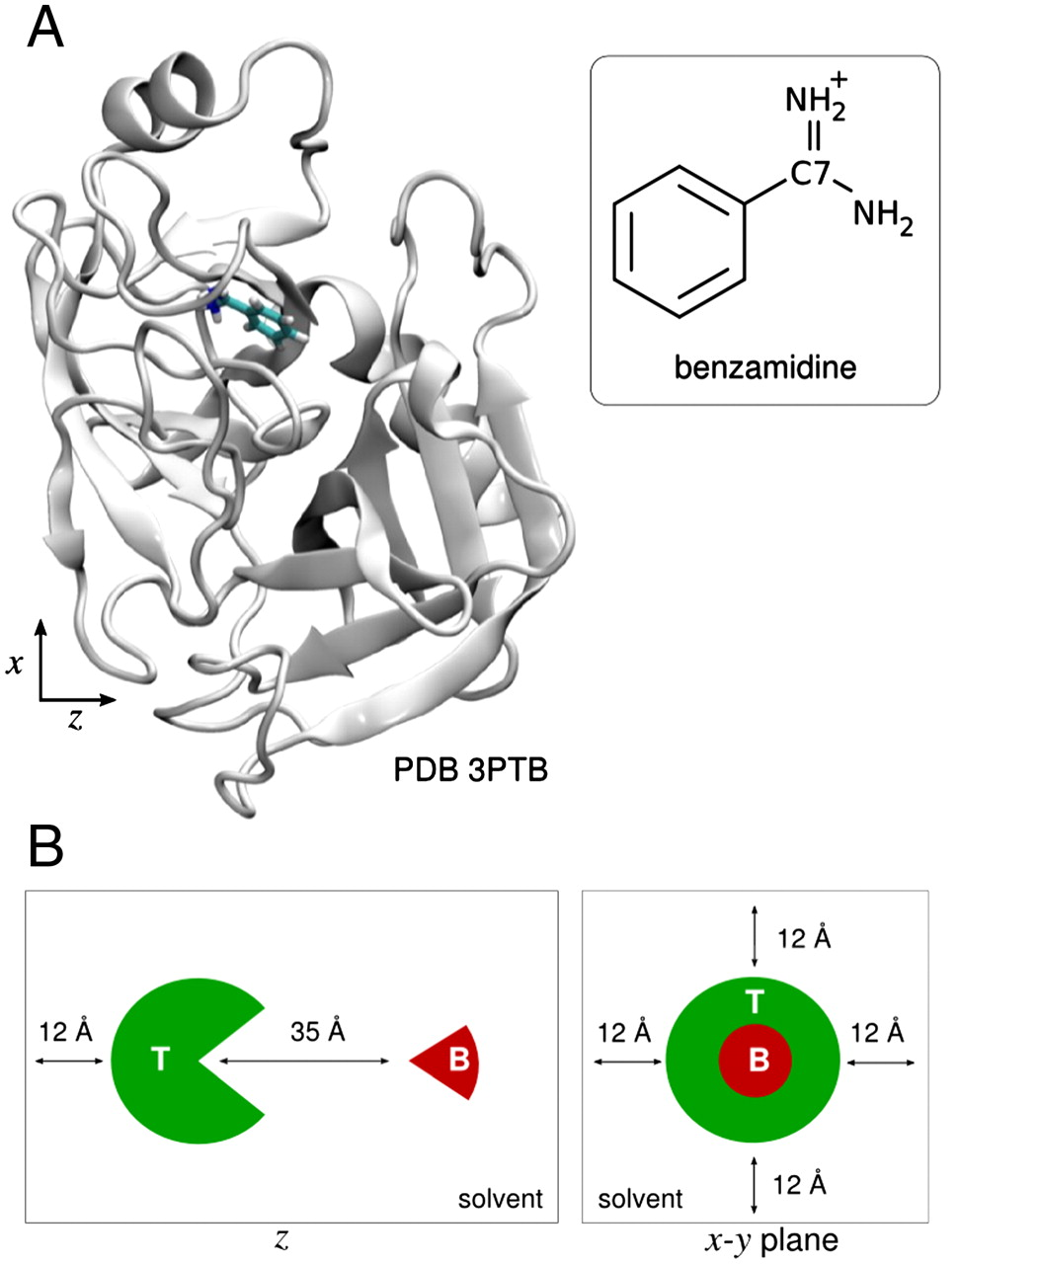
Rigid ligand: no internal degrees of freedom
Small ligand: no orientation d.o.f.
States defined as small cubes according just to the position in 3D space
Ignasi Buch et al. PNAS 2011;108:10184-10189

Slide 45
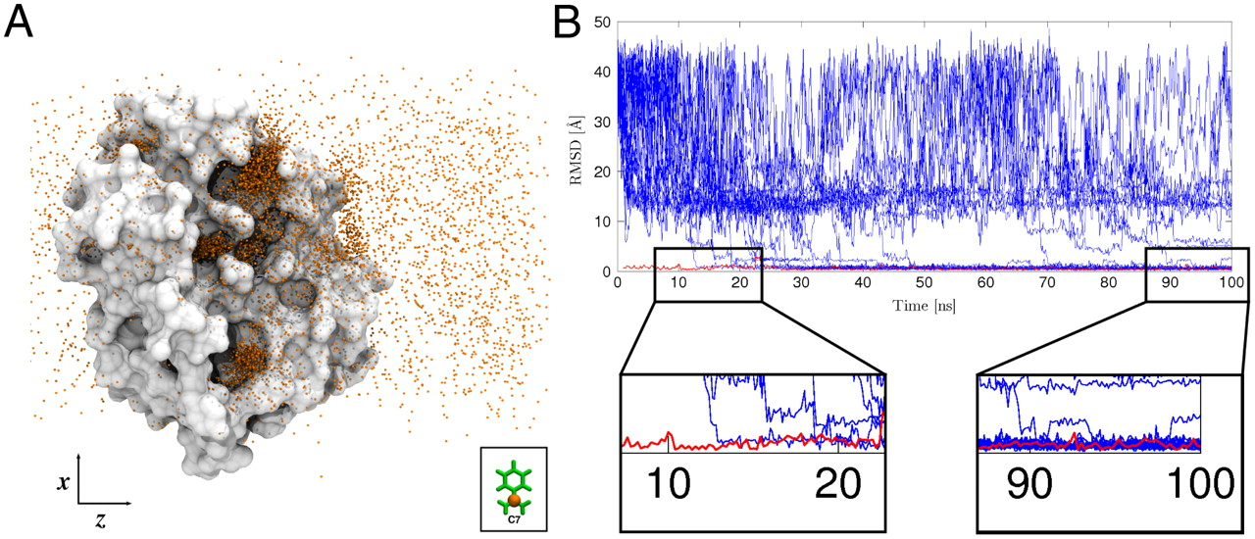

Slide 46
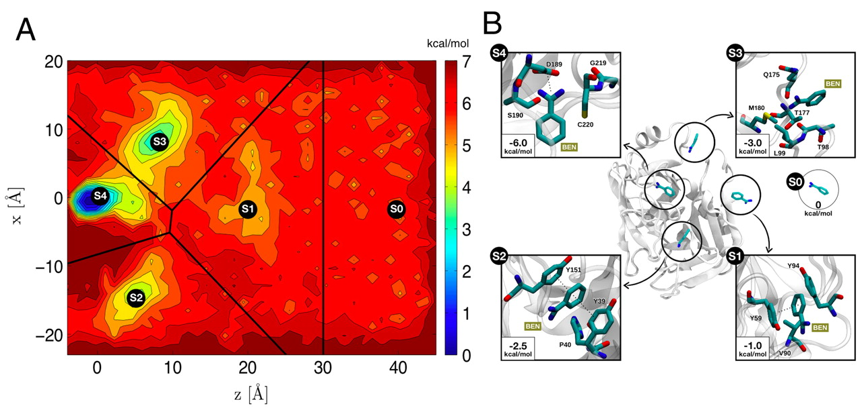
Identification of metastable states.
Identification of metastable states. (A) PMF in the xz plane. Five different metastable states can be identified from the different free-energy minima (S0 to S4). The relative free energy between the unbound state S0 and the bound state S4 is -6 kcal/mol. The most probable transition to the bound state S4 may be from S3 from the fact that the barrier between the two states is just 1.5 kcal/mol. (B) Structural characterization of metastable states. In states S1 and S2, benzamidine is stabilized by π-π stacking interactions with Y151 and Y39 side chains. In S3, a hydrogen bond may be formed between NH2 groups of benzamidine (only heavy atoms shown for clarity) and Q175 side chain, or by a cation-π interaction between the Q175 side chain again, and benzamidine’s benzene ring.
Ignasi Buch et al. PNAS 2011;108:10184-10189

Slide 47
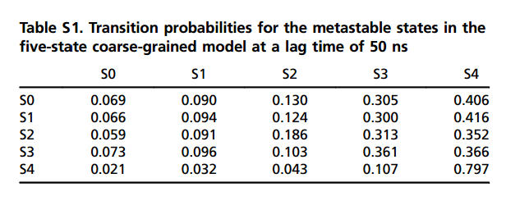
Identification of metastable states.
Identification of metastable states. (A) PMF in the xz plane. Five different metastable states can be identified from the different free-energy minima (S0 to S4). The relative free energy between the unbound state S0 and the bound state S4 is -6 kcal/mol. The most probable transition to the bound state S4 may be from S3 from the fact that the barrier between the two states is just 1.5 kcal/mol. (B) Structural characterization of metastable states. In states S1 and S2, benzamidine is stabilized by π-π stacking interactions with Y151 and Y39 side chains. In S3, a hydrogen bond may be formed between NH2 groups of benzamidine (only heavy atoms shown for clarity) and Q175 side chain, or by a cation-π interaction between the Q175 side chain again, and benzamidine’s benzene ring.
Ignasi Buch et al. PNAS 2011;108:10184-10189

Slide 48
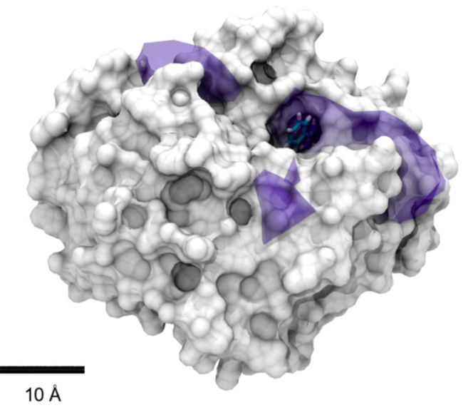
3D PMF isosurface
I meant “benzamidine” not solvent

Slide 49
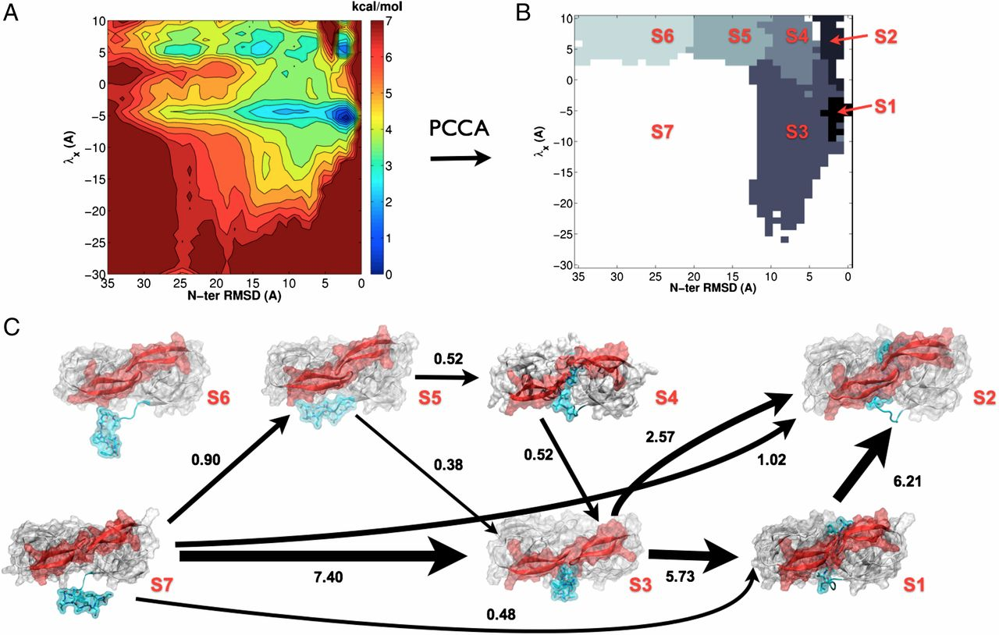
Kinetic characterization of the critical step in HIV-1 protease maturation
www.pnas.org/content/109/50/20449.full

Slide 50
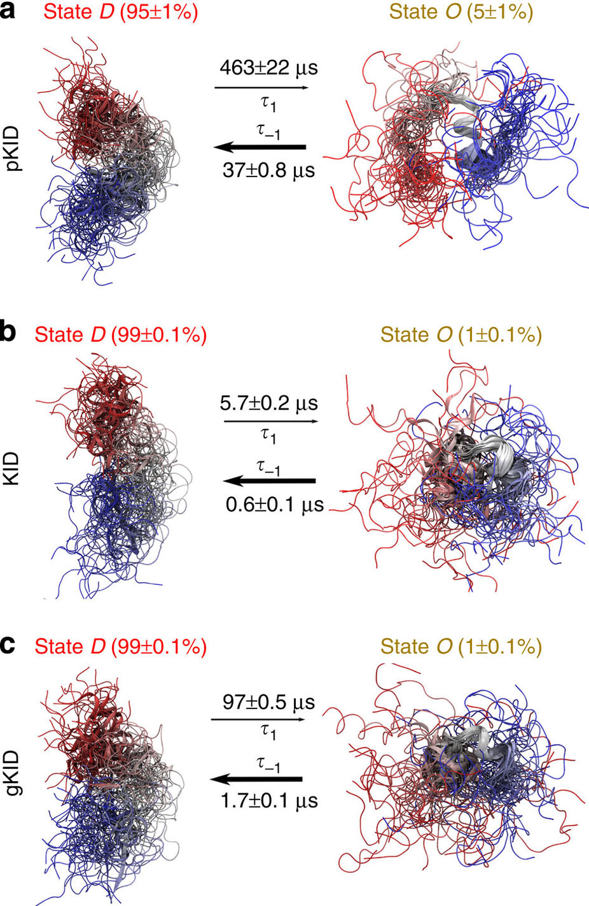
Kinetic modulation of a disordered protein domain by phosphorylation
N. Stanley, S. Esteban and G. De Fabritiis, Nat. Commun. 5, 5272 (2014)
doi:10.1038/ncomms6272
Notes:
This is a figure from a more recent study which analysed the modulation of the confirmational ensemble of a disordered peptide, the kinase inducible domain.
The authors consider the three variations of the peptide: one phosphorylated at serine 133, one unphosphorylated one, and one where serine was mutated to glutamic acid.
They separated the conformational space in “ordered” and “disordered” subspaces.
The interesting thing is that phosphorylation had a relatively small impact on the relative populations of the two states (disorder always dominating), but much more pronounced on the exchange rate between the two (100 fold slower in pKID).

Slide 51
Notes:
Finally here is a study which analyzed the binding of sodium ion to GPCR. As you know, GPCRs are 7-helix TM receptors of enormous pharmacological importance (targets of approximately 30% of the marketed drugs). In the past, MD and crystallographics studies had shown that sodium ion can bind at a specific location far inside the receptor. The authors of this study modelled the whole transition pathway from the extracellular space to the orthosteric binding site. They repeat the same for class B receptors, showing that the residence time is much smaller.

Slide 52
Conclusions and Resources

Slide 53
Warning
Still very active field
Suggested further steps: worked out real-world examples distributed with software packages*
For serious work, many more details are in…
the theory of Markov state models
the discretization, projection, and estimation of models from trajectories
* see the last slides

Slide 54
Conclusions
MSM methods may be an attractive formalism for medium-sized problems
Make efficient use of unbiased sampling
Still require huge (but achieavable) amounts of sampling/simulation for biologically interesting systems
Strong mathematical foundation, with good software available

Slide 55
Software + Tutorials
All are Python-based
They include clear walkthroughs (highly recommended) with datasets
DeepTime-ML – deeptime-ml.github.io ←
HTMD – www.htmd.org
Also analysis + system build + adaptive …
Can aggregate large-scale datasets
MSMBuilder - msmbuilder.org

Slide 56
Related topics
If you liked this, you may also like…
Estimation of reversible transition matrices
Hidden Markov Models doi:10.1063/1.4828816
TICA
Conformational fluxes
Adaptive sampling
Role of drug residence time in drug discovery

Slide 57
Literature
Buch et al., 10.1073/pnas.1103547108
Rigid ligand + protein association, simplest case
Swinney, PMID:19152211
Importance of kinetics in drug design
Chodera and Noe, 10.1016/j.sbi.2014.04.002
Excellent overview (1)
Voelz et al., 10.1021/ja9090353
Full reconstruction of a millisecond folding
Selvam et al., 10.1002/anie.201708889
Reconstruction of Na++ binding to GPCRs
Pande et al., 10.1016/j.ymeth.2010.06.002
Excellent overview (2)
Paul et al., 10.1038/s41467-017-01163-6
Peptide-peptide association
Doerr et al., 10.1021/ct400919u
Adaptive sampling
Bryan et al., “The $25 B eigenvector”
The original PageRank algorithm; e.g. jdc.math.uwo.ca/M1600b/l/pagerank-1600.pdf

Slide 58
End

